Slide 1
Fault-Tolerant Services

Slide 2
1. Introduction
Fault tolerance ensures a system behaves correctly despite failures (e.g., server crashes, network partitions). Two main replication strategies achieve this:
Passive(Primary-Backup) Replication
Active Replication
To ensure correctness, two consistency models are used:
Linearizability: Operations appear instantaneous and ordered by real time.
Sequential Consistency: Operations follow program order per client, not real-time order.

Slide 3
2. Passive (Primary-Backup) Replication
Goal: Ensure high availability and consistency by designating a primary replica manager that handles all client requests. Backups remain idle until the primary fails.

Slide 4
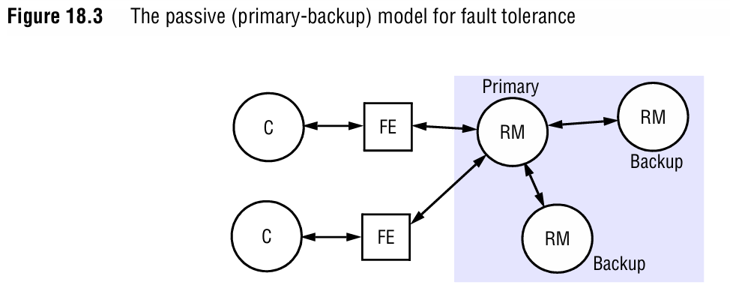
2. Passive (Primary-Backup) Replication

Slide 5
2. Passive (Primary-Backup) Replication
Architecture:
Primary: Processes client requests, updates backups.
Backups: Maintain copies of data; take over if the primary fails.
Clients: Communicate only with the primary.
Clients send requests to the primary updates are propagated to backups.

Slide 6
2. Passive (Primary-Backup) Replication
Steps for Handling a Request
Request: Client sends a request to the primary.
Coordination: Primary checks for duplicate requests (using unique IDs).
Execution: Primary applies the operation to its state.
Agreement: Primary sends the update to all backups (via view-synchronous communication).
Response: Primary replies to the client.

Slide 7
2. Passive (Primary-Backup) Replication
Failure Handling:
If the primary crashes, the system elects a new primary using view-synchronous communication.
The new primary and backups agree on the latest state (no updates are lost or duplicated).
Trade-offs:
Pros: Simple consistency, ideal for high-consistency systems (e.g., databases).
Cons: Single point of failure (until failover), latency during failover.

Slide 8
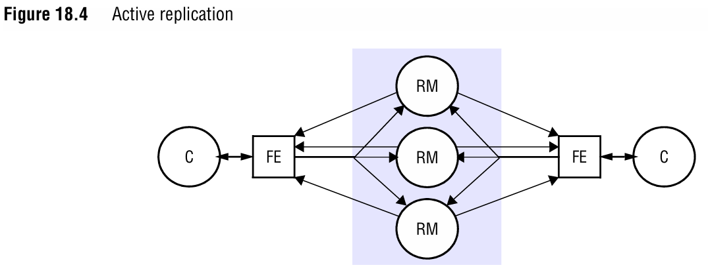
3. Active Replication
Goal: Eliminate single points of failure by having all replica managers process requests.

Slide 9
3. Active Replication
Architecture:
All replica managers(RMs) actively process requests.
Clients multicast requests to all RMs using totally ordered, reliable multicast.
RMs execute operations in the same global order.
Clients multicast requests; all RMs process operations in the same order.

Slide 10
3. Active Replication
Architecture:
Clients multicast requests; all RMs process operations in the same order.
Steps for Handling a Request
Request: Client multicasts the request to all RMs.
Coordination: RMs deliver the request in total order (via consensus protocols like Paxos/Raft).
Execution: Each RM executes the request deterministically (as state machines).
Agreement: No explicit phase needed (total order ensures consensus).
Response: Each RM sends a response; the client uses the first reply (or majority).

Slide 11
3. Active Replication
Failure Handling:
Surviving RMs continue processing requests.
No single point of failure; tolerates up to f failures with 2f+1 replicas (Byzantine fault tolerance).
Trade-offs:
Pros: High availability, no failover delay.
Cons: Requires total ordering (complex coordination), higher overhead.

Slide 12
4. Consistency Models
Linearizability
Operations appear to execute atomically in real-time order.
Example: A bank balance update must be seen by all clients immediately.
Achieved in passive replication (primary sequences all operations).

Slide 13
4. Consistency Models
Sequential Consistency
Operations follow program order per client but not real-time order.
Example: Chat messages appear in the order sent, even if delayed.
Achieved in active replication (total order of operations).

Slide 14
5. Role of Group Communication
Group communication ensures RMs coordinate to maintain consistency during failures:
View-Synchronous Communication:
All RMs agree on membership change(e.g., primary failure)
Delivers message consistently across the group.
Key properties:
Order: All processes deliver the same sequence of views.
Integrity: A process in a view sees itself.
Non-Triviality: Eventually includes all reachable members.

Slide 15
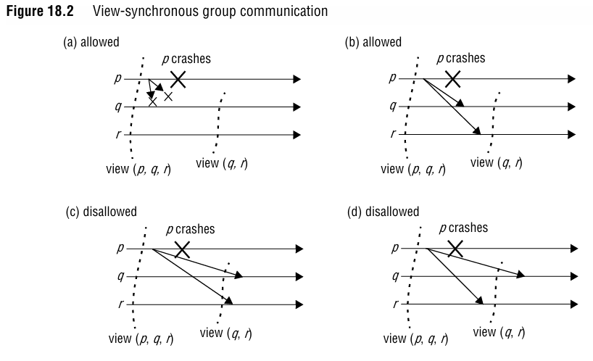
5. Role of Group Communication
If RM p crashes, remaining RMs agree on a new view excluding p.
Messages are delivered either before or after the view change, ensuring consistency.

Slide 16
6. Trade-offs Between Passive and Active Replication
ASPECT | Passive Replication | Active Replication
Consistency | Linearizability | Sequential consistency
Fault Tolerance | Requires failover | No single point of failure
Performance | Lower (single primary) | Higher (parallel processing)
Use Cases | Databases, financial systems | Real-time systems (e.g., air traffic control)

Slide 17
7. Summary
Fault-tolerant services use replication to mask failures:
Passive replication simplifies consistency but has a single point of failure.
Active replication provides high availability but requires coordination.
View-synchronous communication ensures agreement during failures.
Correctness is enforced via linearizability (strict order) or sequential consistency (program order).
By combining these strategies, systems balance availability, consistency, and performance to meet application needs.

